Slide 1
Mobile Application System Design
(Chap 3 Part 1)

Slide 2
Key Concepts:
Widgets and Widgets Trees
Function and Arguments
Property and Values
MaterialApp and Scaffold
Container, Center & Text Widgets
const and final
Stateless and Stateful Widgets

Slide 3
Widget & Widget Trees
MaterialApp
Widget – Small building block of your app
Visible : things you see (text, image, button)
Invisible : things that hold other widgets (Container, Column, Center)
Scaffold
Widget Tree – The structure connecting all widgets together
Center
Parent widget: The one that contains another widget
Child widget: The one inside the parent
Text

Slide 4
Properties and Values
Property – Setting or option for a widget. It tells Flutter what this widget should look like or do
For example: color
Value – What you assign to a property
For example: blue
WidgetName( propertyName: value,
)
QUESTION ?
“If I want to make a screen with pink background and white text in the center that says ‘Welcome’, what are the widgets, properties, and values I’d use?”

Slide 5
MaterialApp and Scaffold Widgets
MaterialApp – Main container of your whole app
Scaffold – What gives your app its basic screen structure
MaterialApp
└── Scaffold
├── appBar: Title of the app
├── body: Main screen content
├── floatingActionButton: Button for quick actions
└── drawer: Side menu

Slide 6
Container, Center & Text Widgets
Container Widget – A box that you can style, color, resize, or even decorate
Center Widget – Centers whatever is inside it
Text Widget – How we display any text or label on the screen

Slide 7
const and final
const – The value will never change
For example:
const Text (“Welcome”) const Color (0xFF2196F3)
final – The value cannot change but the difference is, the value is decided later, when the app is running
For example:
final DateTime today = DateTime.now();

Slide 8
Stateless vs Stateful Widgets
Stateless Widget – Something that never changes once it’s built on the screen
For example:
Logo
Tittle text
Background image
Fixed button
Stateful Widget – Something that can change while the app is running
For example:
Login form
Play/pause button

Slide 9
CLASS ACTIVITY
(Hands-On Practice)

Slide 10
Building Your First App
This week you will start building your first app where a lot of new mobile development concepts will be covered
Widget and Widget Trees (e.g. text, image, button etc)
Function and Arguments
const and final value
stateless and stateful widget

Slide 11
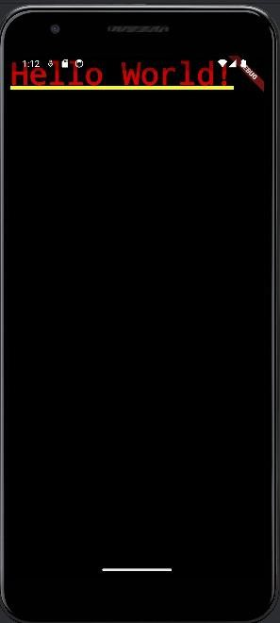
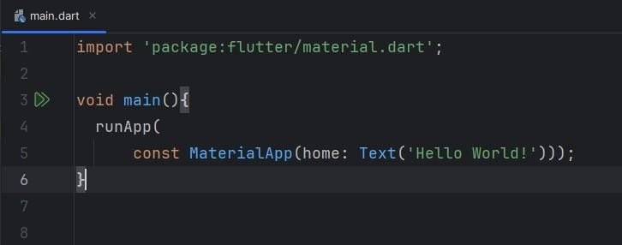
Example 1 App

Slide 12
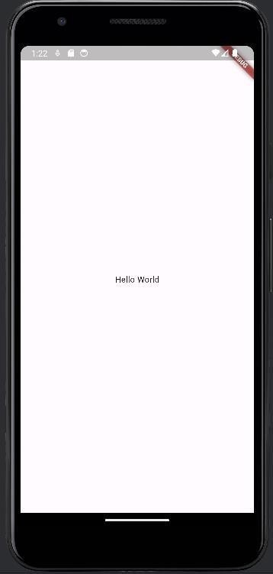
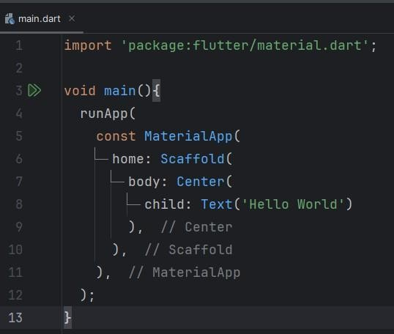
Example 2 App

Slide 13
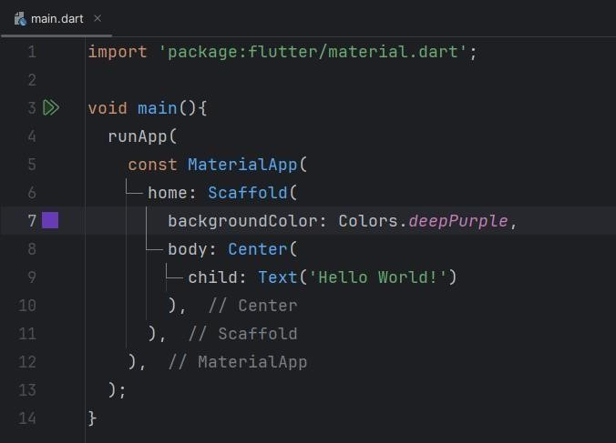
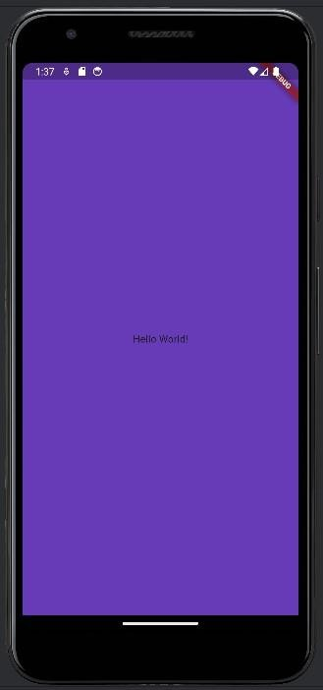
Example 2 App

Slide 14
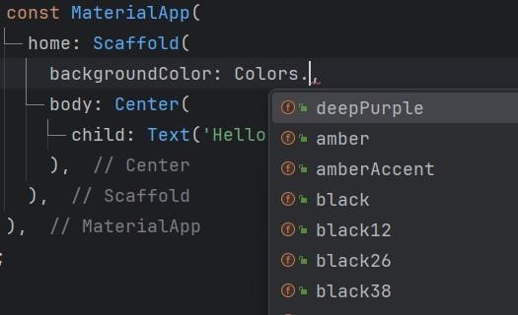
Example 2 App

Slide 15
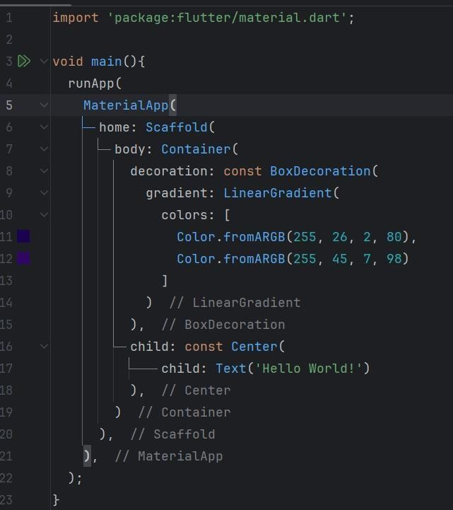
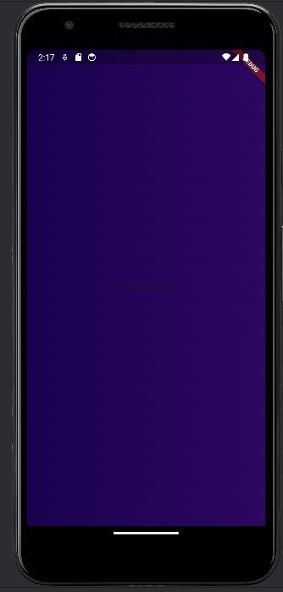
Example 3 App

Slide 16
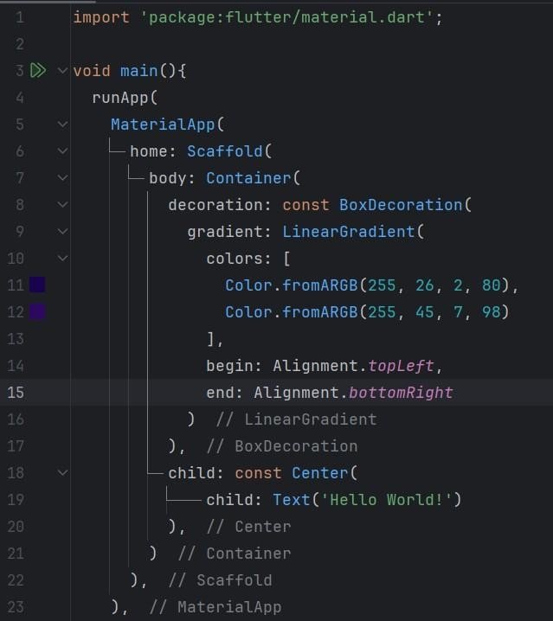
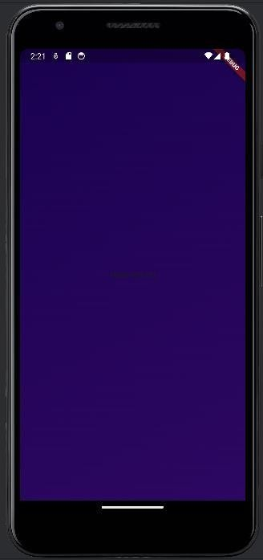
Example 3 App

Slide 17

BASIC RULE
Widget – A building block of UI. Visible or Structural Property – A setting or configuration inside a widget.
Value – The data or object passed to the property.

Slide 18


MaterialApp widget
home: → Property of MaterialApp
Scaffold(...) → Widget that is the value of home
Scaffold widget
body: → Property of Scaffold
Container(...) → Widget that is the value of body

Slide 19
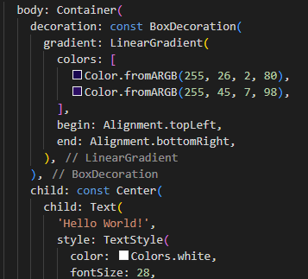
Container, Center & Text widget
decoration: (Property of Container)
decoration: is the property name
BoxDecoration(...) is the value or object we pass to apply styling (like gradients, borders)
Inside BoxDecoration
gradient: is the property
LinearGradient(...) is the object that creates the color transition
Inside LinearGradient
colors: → Property of LinearGradient
Color.fromARGB(...) → Values (they define which colors to blend)
child: (Another property of Container)
child: is a property of the Container
Center(...) is a widget that centers its child
Inside Center: child: Text(...)
child: is a property of the Center widget
Text(...) is a widget to display a line of text
Inside Text: Styling with TextStyle
style: → Property of Text
TextStyle(...) → Object that controls how the text looks

Slide 20
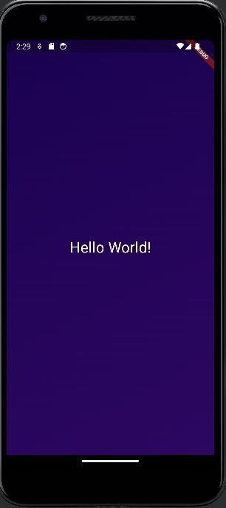
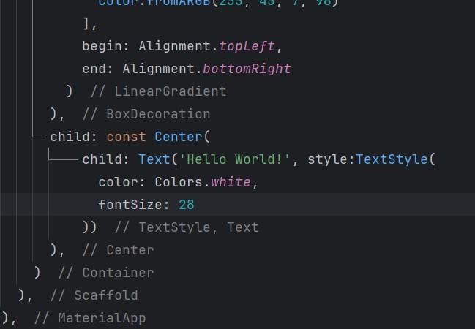

Example 3 App

Slide 21
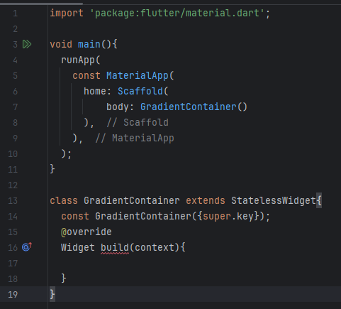
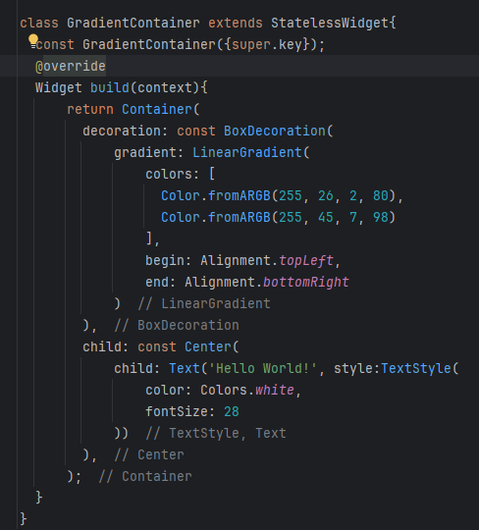
Example 4 App

Slide 22
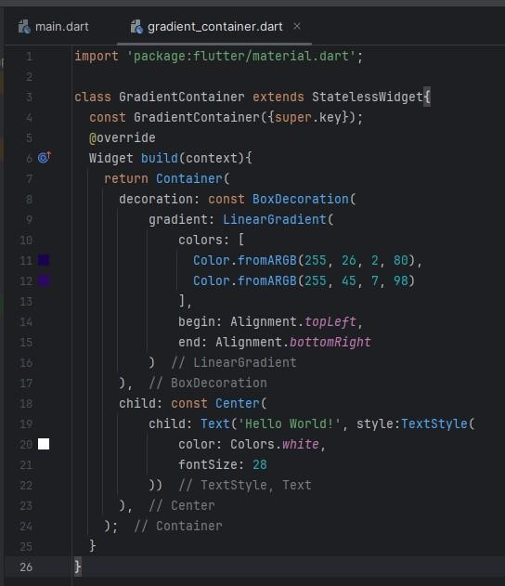
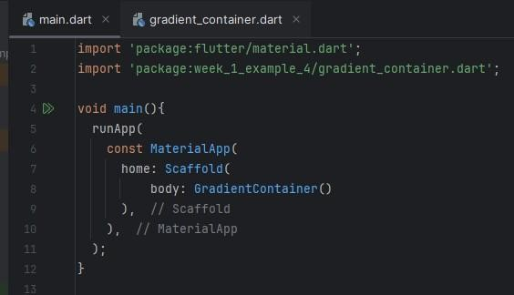
Example 4 App
gradient_container.dart
main.dart

Slide 23
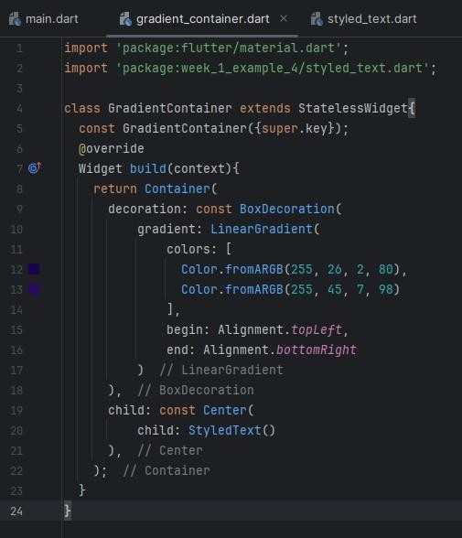
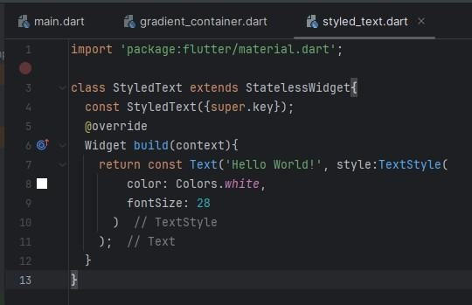
Example 4 App
styled_text.dart
gradient_container.dart

Slide 24
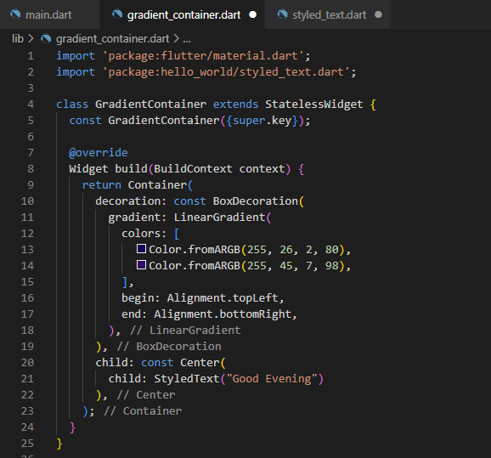
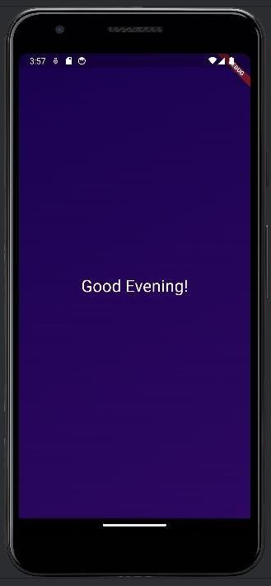
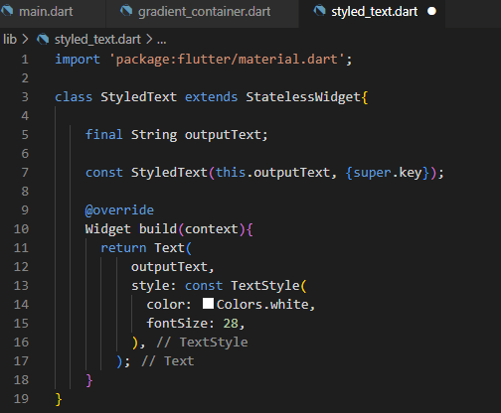
Example 4 App
styled_text.dart
gradient_container.dart

Slide 25
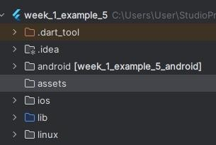
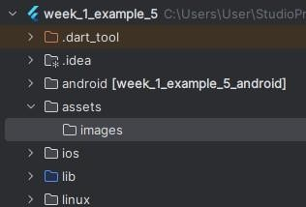
Example 5 App
Create a new folder
Create a subfolder

Slide 26
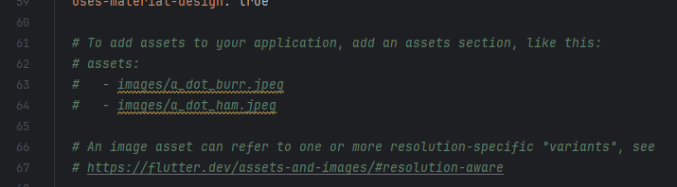
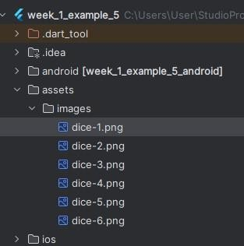
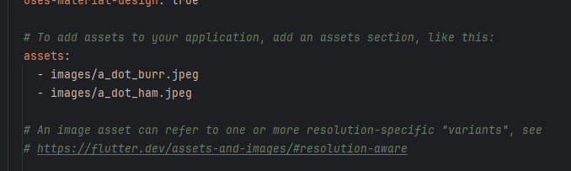
Example 5 App
Remove the “#”
Copy and paste the images to “images” subfolder
pubspec.yaml

Slide 27
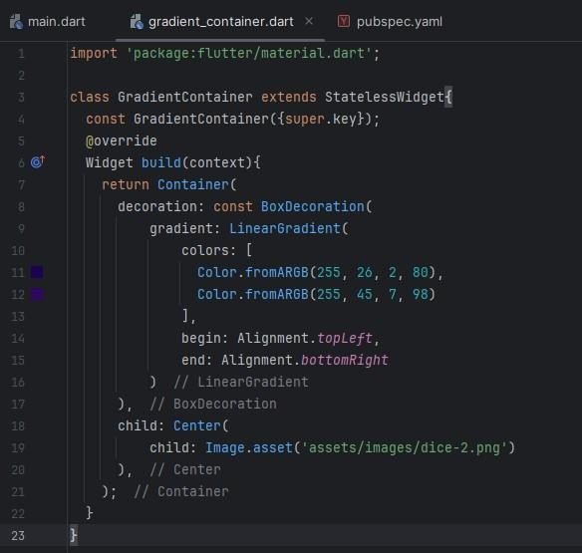
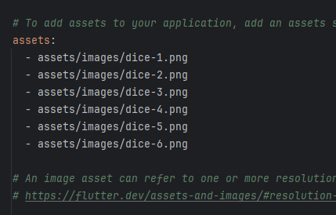
Example 5 App
pubspec.yaml
gradient_container.dart

Slide 28
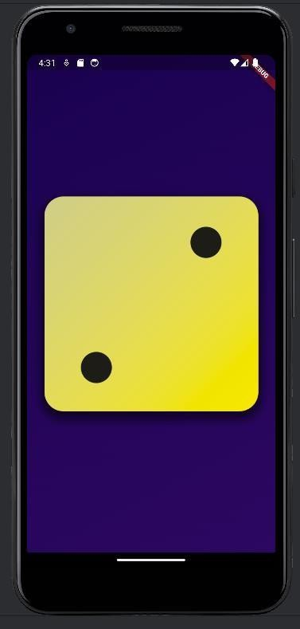
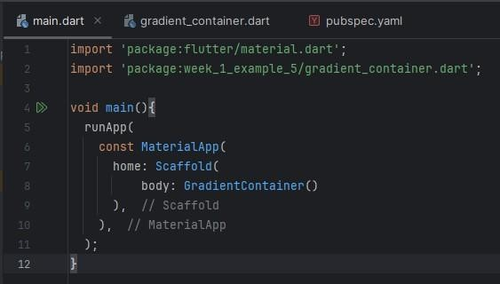
Example 5 App
main.dart

Slide 29
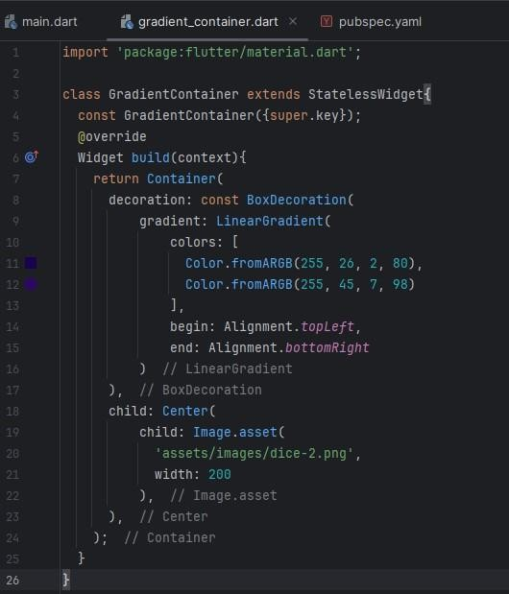
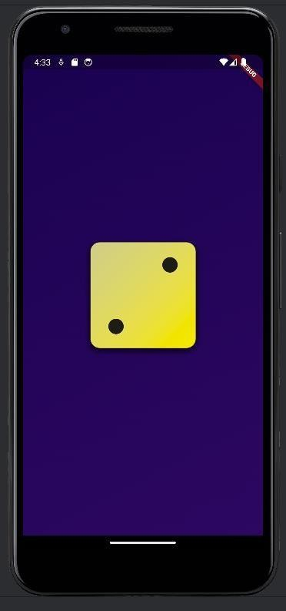
Example 5 App
gradient_container.dart

Slide 30
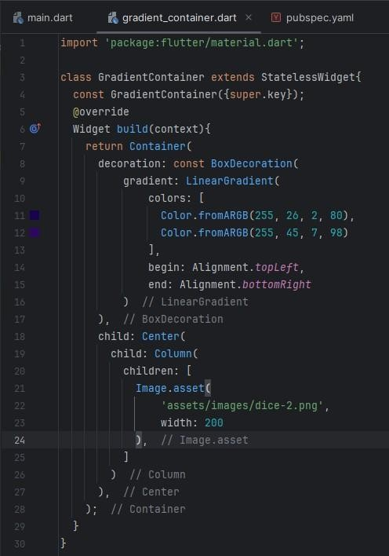
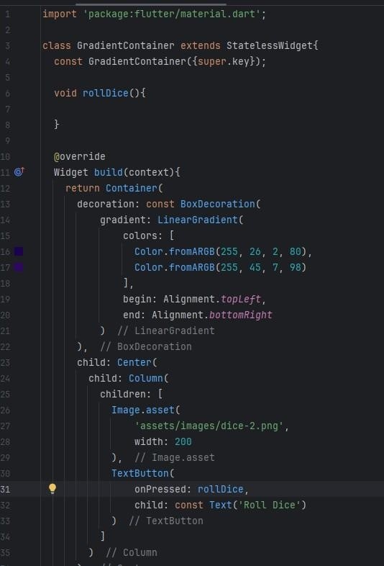
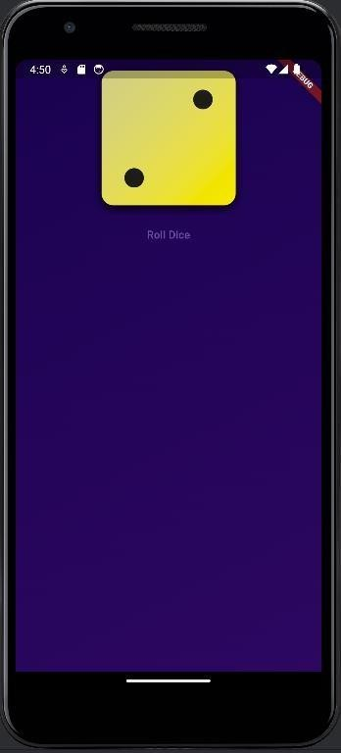
Example 5 App
gradient_container.dart
gradient_container.dart

Slide 31
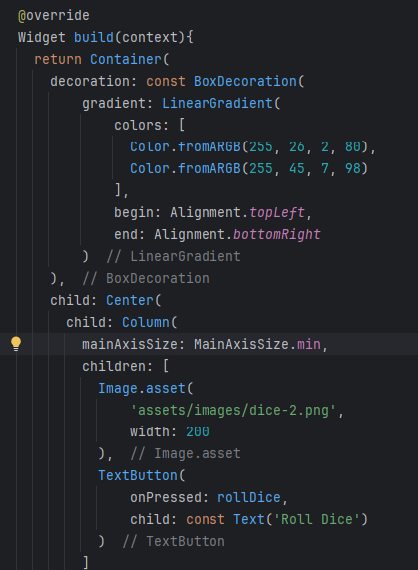
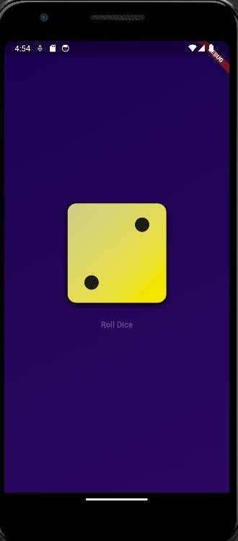
Example 5 App
gradient_container.dart

Slide 32
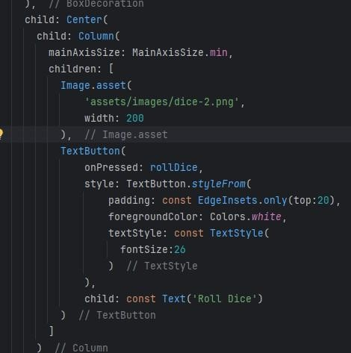
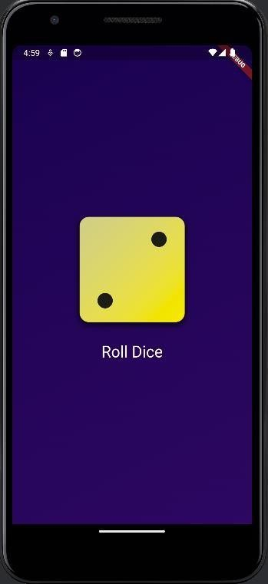
Example 5 App
gradient_container.dart

Slide 33
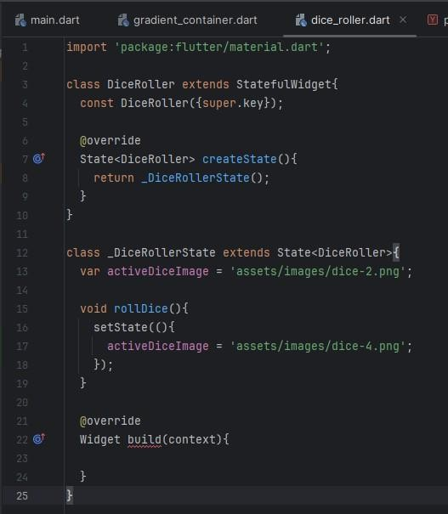
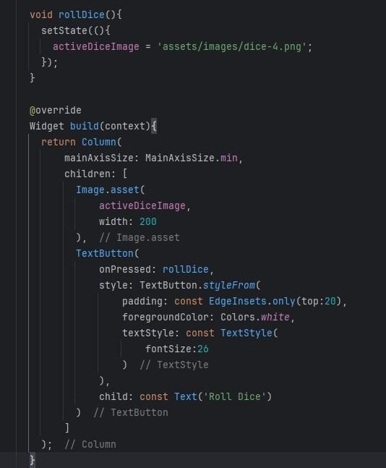
Example 5 App
Change to
variable name
dice_roller.dart
dice_roller.dart

Slide 34
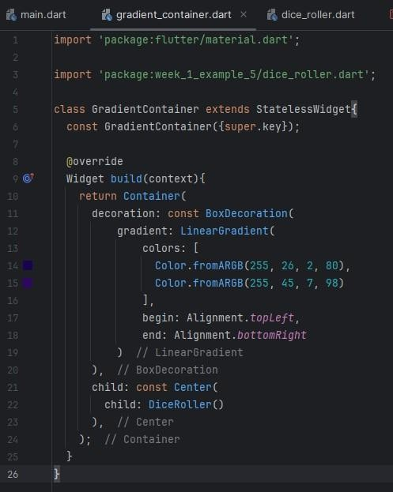
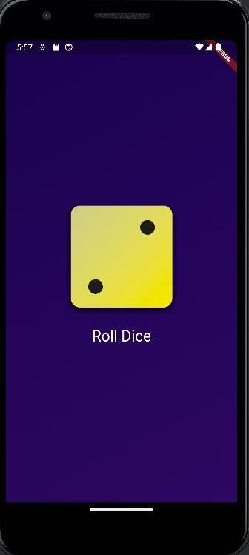
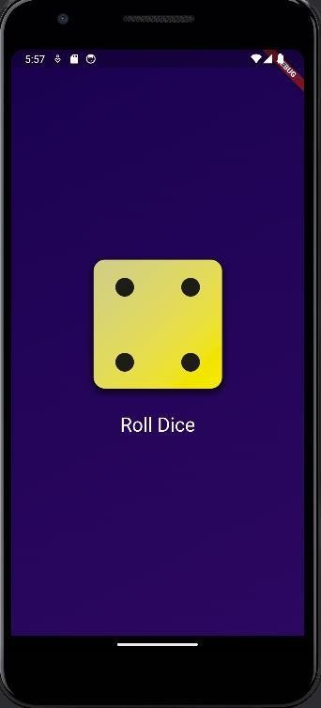
Example 5 App
Click
gradient_container.dart

Slide 35
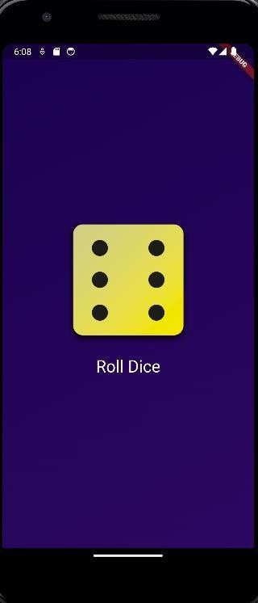
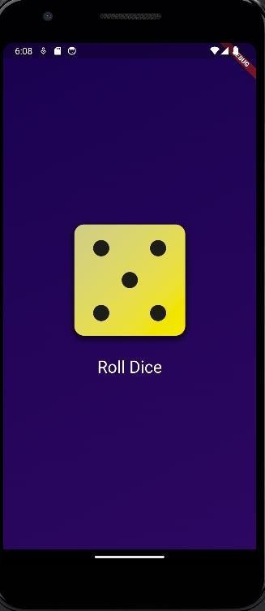
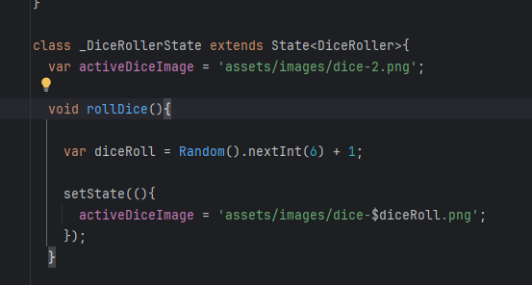
Example 5 App
dice_roller.dart

Slide 36
See you next class

